Slide 1

Chapter 6
Modern Data Quality Management with Talend Prep & Emerging Technologies - Leveraging AI, Cloud, and Automation for Enhanced Data Quality
Teh Ying Wah
tehyw@um.edu.my
University of Malaya

Slide 2
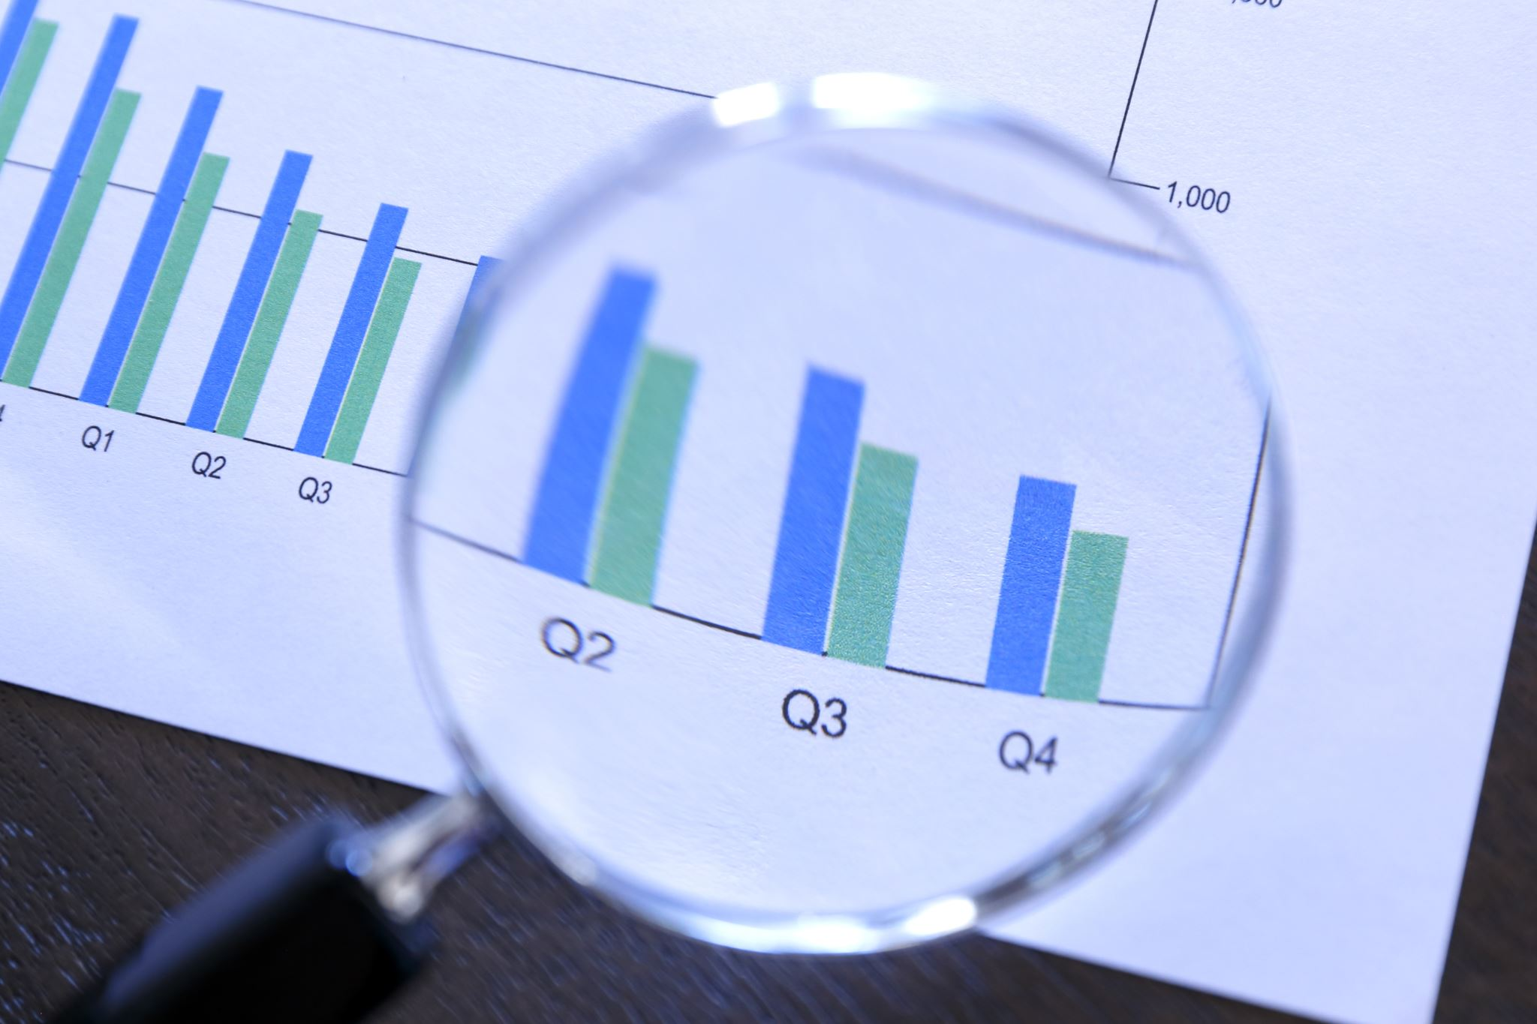
Course outline
Brief Overview of Data Quality: Importance and Challenges
Challenges in Ensuring Data Quality
Introduction to Talend Data Prep: Role in Data Quality Management
Role in Data Quality Management
The Data Quality Lifecycle: From Profiling to Monitoring
Data Standardization
Data Validation
Data Enrichment
Data Monitoring

Slide 3

Learning Objectives
Understand the Importance of Data Quality
Familiarize with Data Quality Management Tools
Comprehend the Data Quality Lifecycle
Master Techniques for Data Improvement
Implement Data Monitoring Strategies
Leveraging AI, Cloud, and Automation for Enhanced Data Quality

Slide 4

Brief Overview of Data Quality: Importance and Challenges
1.1. Decision Making:
High-quality data is the backbone of informed decision-making. Organizations rely on accurate, timely, and relevant data to make strategic choices, allocate resources, and forecast trends.
1.2. Operational Efficiency:
Clean and organized data streamlines business operations. It reduces errors, increases productivity, and ensures that systems and processes function optimally.
1.3. Customer Trust and Satisfaction:
Accurate data plays a pivotal role in ensuring customer satisfaction. Whether it's maintaining accurate contact information or ensuring that orders are fulfilled correctly, data quality directly impacts the customer experience.

Slide 5
Brief Overview of Data Quality: Importance and Challenges
1.4. Compliance and Risk Management:
Many industries have regulations that mandate the accuracy and privacy of data. High-quality data is essential to meet these requirements and mitigate risks associated with data breaches or misinformation.
AI-driven tools are increasingly essential for managing regulations like GDPR (General Data Protection Regulation), CCPA (California Consumer Privacy Act), and other privacy and data protection laws. These tools help automate compliance, detect risks, and ensure data governance while reducing the need for manual intervention
1.5. Financial Impact:
Poor data quality can have significant financial implications. Whether it's through missed opportunities, resource wastage, or costly errors, the financial ramifications of poor data quality can be substantial.

Slide 6

Brief Overview of Data Quality: Importance and Challenges
Real-time Data Quality has become increasingly crucial due to the rise of big data streams in modern business operations. Organizations today generate and collect vast amounts of data from multiple sources, including IoT devices, social media, mobile apps, and sensors, often processed in real-time.
Maintaining the quality of this data while it flows into systems is essential for ensuring that the data remains accurate, consistent, timely, and reliable for decision-making and analysis.

Slide 7
2. Challenges in Ensuring Data Quality
2.1. Volume and Velocity of Data:
With the explosion of big data, organizations are dealing with vast amounts of data generated at unprecedented speeds. Managing the quality of such massive datasets in real-time is challenging.
2.2. Data Silos:
Many organizations have data stored in disconnected systems or silos. Ensuring consistency and accuracy across these disparate systems can be a daunting task.
2.3. Diverse Data Sources:
Data now comes from a myriad of sources, including IoT devices, social media, and third-party providers. Each source can have its own format, standards, and quality issues.

Slide 8
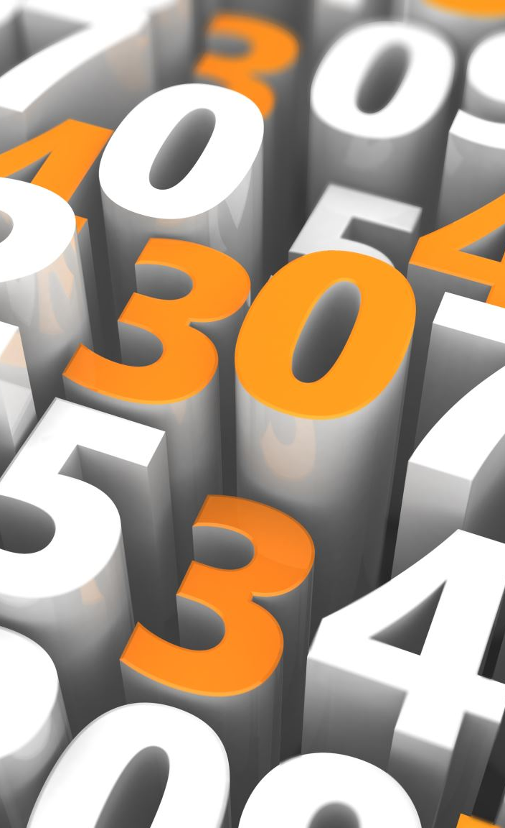
2. Challenges in Ensuring Data Quality
2.4. Lack of Standardization:
Without standardized processes and formats, data can become inconsistent. This poses challenges in integration, analysis, and reporting.
2.5. Human Error:
Data entry errors, misinterpretations, or misunderstandings can introduce inaccuracies into the dataset.
2.6. Evolving Data:
Data is not static. As it evolves and changes over time, maintaining its quality and relevance becomes challenging.
2.7. Inadequate Tools and Infrastructure:
Not having the right tools or systems in place can hinder an organization's ability to monitor, clean, and maintain high-quality data.

Slide 9

Introduction to Talend Data Prep: Role in Data Quality Management
What is Talend Prep?
Talend Data Preparation is a self-service tool within the Talend suite designed specifically for cleaning and preparing data. It allows users, including those without extensive technical expertise, to access, cleanse, and transform data.
Key Features of Talend Prep:
User-Friendly Interface: Enables non-technical users to clean and transform data with ease.
Data Profiling: Visualizes data quality and identifies anomalies.
Transformation Suggestions: Provides suggestions based on the data's content and pattern.
Collaboration: Allows users to share preparation steps and datasets.

Slide 10
Summary of Differences and Use Cases
Talend Data Prep is ideal for businesses seeking flexibility and hybrid deployment options. It caters to both technical and non-technical users, providing advanced AI-powered data quality and collaboration features. Talend’s focus on integrating both cloud and on-premises environments makes it versatile, but it may come with a higher cost compared to fully cloud-native tools.
Google Cloud DataPrep is best suited for organizations within the Google Cloud ecosystem. It provides an extremely user-friendly experience with a focus on ease of use, enabling data analysts to transform data visually. It is powerful for teams looking for serverless data wrangling capabilities integrated closely with GCP services, but lacks more advanced ETL capabilities compared to AWS Glue.
AWS Glue is a more developer-oriented tool with powerful capabilities for managing complex data transformations in a serverless environment. It integrates tightly with AWS’s analytics and storage services, making it ideal for large-scale big data ETL workflows. AWS Glue’s real-time streaming capabilities with Glue Streaming Jobs also make it a good choice for high-volume data scenarios, though it has a steeper learning curve compared to Talend and DataPrep.
Selecting the right tool depends on your organization's specific requirements, including the need for cloud-native deployment, hybrid architecture, the level of user expertise, and the preferred cloud platform.

Slide 11
3. Role in Data Quality Management
3.1. Data Profiling and Cleansing:
Talend Prep helps users identify issues with their data, such as missing values, duplicates, or inconsistencies, and provides tools to address these issues.
3.2. Data Standardization:
With Talend Prep, users can ensure that data is consistent in format and structure, making it easier to integrate and analyze.
3.3. Data Validation:
By setting up validation rules, users can ensure incoming data meets specific criteria, ensuring the accuracy and reliability of data.

Slide 12

3. Role in Data Quality Management
3.4. Continuous Monitoring:
Talend Prep provides the tools to monitor data quality metrics over time, allowing organizations to understand and maintain the quality of their data.
3.5. Collaboration and Governance:
Data quality is a team effort. Talend Prep's collaboration features ensure that data stewardship and governance are integrated into the data preparation process.

Slide 13

4. The Data Quality Lifecycle: From Profiling to Monitoring
The Data Quality Lifecycle represents a systematic approach to ensuring and maintaining the quality of data throughout its life in an organization.
This lifecycle aims to address and manage data quality issues at various stages, ensuring that data remains accurate, timely, consistent, and relevant.

Slide 14
4.1. Data Profiling[1]
4.1.1. Definition:
Data profiling is the process of examining data to understand its structure, content, relationships, and quality anomalies.
4.1.2. Importance:
This step provides a clear picture of the current state of the data, highlighting areas that need attention or improvement.
4.1.3. Tools & Techniques:
Statistical analysis, data type recognition, and anomaly detection.
modern tools like AI-driven profiling in Pandas Profiling, Great Expectations, and Talend can automatically detect anomalies.

Slide 15
4.2. Data Cleaning[1]
4.2.1. Definition:
Data cleaning involves identifying and correcting (or removing) errors and inconsistencies in data to improve its quality.
4.2.2. Importance:
It ensures data is accurate and trustworthy, which is crucial for analytics, reporting, and decision-making.
4.3. Tools & Techniques:
Error correction, outlier detection, and data imputation.
modern techniques such as AI-based error correction or machine learning imputation models.
new tools like dbt for data cleaning in pipelines or Apache NiFi for automated cleansing in real-time processing.

Slide 16
4.3. Data Standardization
4.3.1. Definition:
Data standardization is the process of bringing data into a uniform format and structure, making it easier to integrate, analyze, and use.
4.3.2. Importance:
Consistent data formats improve the efficiency of data integration and analytics processes.
4.3.3. Tools & Techniques:
Format standardization, unit conversions, and code replacements.
automated standardization workflows using tools like Talend, Trifacta, or Google Cloud DataPrep.

Slide 17

4.4. Data Validation
4.4.1. Definition:
Data validation ensures that incoming or existing data meets predefined standards and criteria.
4.4.2. Importance:
Validation ensures that data is not only accurate but also relevant and fit for its intended use.
4.4.3. Tools & Techniques:
Rule-based checks, pattern matching, and cross-referencing.

Slide 18
4.5. Data Enrichment [2]
4.5.1. Definition:
Data enrichment involves augmenting existing data with additional, relevant information from external sources.
4.5.2. Importance:
Enriched data provides a more holistic view and can lead to more informed decision-making.
4.5.3. Tools & Techniques:
Data appending, data blending, and third-party data integration.
real-time enrichment using APIs like Clearbit, FullContact, or Factual.
modern API integration examples (e.g., appending customer data with social media or geolocation data).

Slide 19

4.6. Data Monitoring
4.6.1. Definition:
Data monitoring is the continuous tracking and review of data quality metrics over time.
4.6.2. Importance:
Ongoing monitoring ensures that data quality remains high and that any emerging issues are addressed promptly.
4.6.3. Tools & Techniques:
Quality dashboards, alerts, and trend analysis.

Slide 20
Summary and Use Cases:
Monte Carlo and Bigeye are focused on continuous data quality monitoring with AI-driven anomaly detection in real-time, making them suitable for large-scale production environments where reliability and quick response to data issues are essential.
Monte Carlo excels in data observability, especially for tracing issues, while Bigeye offers a more accessible and cost-effective solution for organizations that need straightforward monitoring and anomaly detection.
Google Cloud DataPrep, while useful for ad-hoc data transformation and quality checking, is more suitable for smaller-scale operations focused on interactive use cases within the Google Cloud ecosystem, rather than full-fledged observability across distributed data pipelines.

Slide 21

4.7. Feedback & Iteration
4.7.1. Definition:
Based on monitoring results and feedback, the data quality process is refined and improved.
4.7.2. Importance:
Data needs and environments are dynamic. Iteration ensures that the data quality process remains effective and relevant.
4.7.3. Tools & Techniques:
Feedback loops, process reviews, and continuous improvement methodologies

Slide 22

Modern DataOps and AI-driven Data Quality
Netflix applies DataOps to ensure data quality across its massive data pipelines used for content recommendations. By integrating real-time monitoring, Netflix continuously validates the quality of data being ingested and processed, ensuring reliable insights for viewers.
Uber uses DataOps principles to handle real-time data generated from its rides. Automated data quality checks and monitoring ensure data reliability for features like fare calculations, ETA predictions, and driver ratings.

Slide 23

Modern DataOps and AI-driven Data Quality
DataOps is revolutionizing data quality by combining agile adaptability and DevOps automation to create highly collaborative, efficient, and responsive data management practices. The integration of these principles ensures:
Continuous data quality improvement.
Automation of data validation and transformation tasks.
Real-time monitoring and feedback, leading to proactive resolution of issues.
By transforming data management with agile and DevOps methodologies, DataOps creates a robust environment for maintaining high data quality, enabling data-driven organizations to make more reliable, timely, and impactful decisions.

Slide 24
references
[1] https://www.youtube.com/watch?v=0pLMxUxYRAE&ab_channel=Talend
[2] https://www.youtube.com/watch?v=ewjPt-fhdMs&ab_channel=edureka%21

